Slide 1
Lab. 06
Logic Design Lab.
Fall 2019
Prof. Sungjoo Yoo
(yeonbin@snu.ac.kr)
TA. Hyunsu Kim
(gustnxodjs@gmail.com)
TA. Hyunyoung Jung
(gusdud1500@gmail.com)

Slide 2
Contents
Sequential Logic
Oscillator
Latch & F/F
RS Latch
Gated RS Latch
Master-Slave Latches
Lab

Slide 3
Sequential Logic

Slide 4
Sequential Logic
Combinational Logic
Generates same outputs with same inputs
Output depends on input values
Sequential Logic
Consist of combinational logic and memory components
Can generate different outputs with same inputs
Output depends on input and memory values
Same input => Same output !
1
MyAdder1
A + B
1
MyAdder1
A + B
1
1
0
0
1
MyAdder2
A + B + M
1
MyAdder2
A + B + M
2
1
0
M=1
0
M=0
Same input ≠> Same output !

Slide 5
Oscillator

Slide 6
Oscillatory Behavior
+
resistor
A
B
open switch
C
D
close switch
initially undefined
open switch

Slide 7
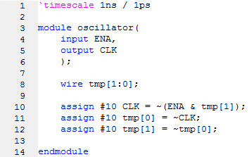
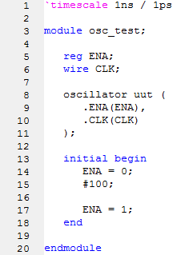
Verilog Implementation (Oscillator)
<Module>
<Sample Testbench>
<Simulation>

Slide 8
Review – latches & F/Fs

Slide 9
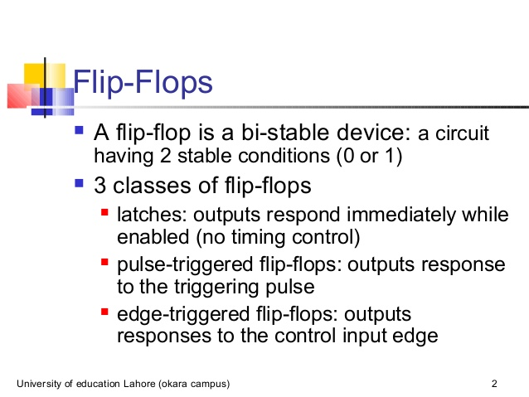

Slide 10
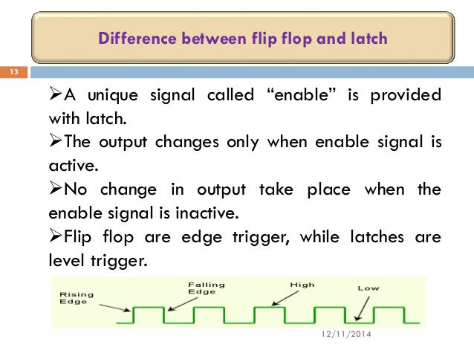

Slide 11
RS Latch

Slide 12


RS Latch analysis
R
Q
S
Q(t+Δ)
S
Q'
R
S R Q(t) Q(t+Δ) 0 0 0 0 0 0 1 1 0 1 0 0 0 1 1 0 1 0 0 1 1 0 1 1 1 1 0 X 1 1 1 X
S
hold
0 0
1 0
X 1
X 1
reset
Q(t)
set
R
not allowed

Slide 13
Timing Behavior
R
Q
S
Q'
Reset
Hold
Set
Reset
Set
100
Race
R
S
Q
\Q

Slide 14
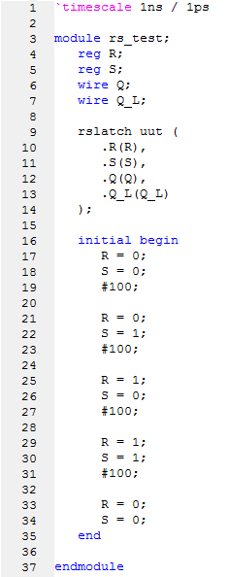
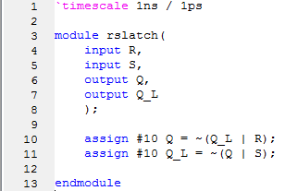
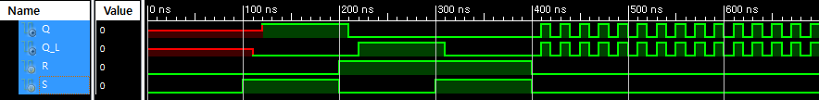
Verilog Implementation (RS Latch)
<Module>
<Sample Testbench>
<Simulation>

Slide 15
Gated RS Latch

Slide 16

Gated RS Latch Analysis
R’
R
Q
enable’
Q’
S’
S
Set
Reset
100
S'
R'
enable’
Q
Q'

Slide 17
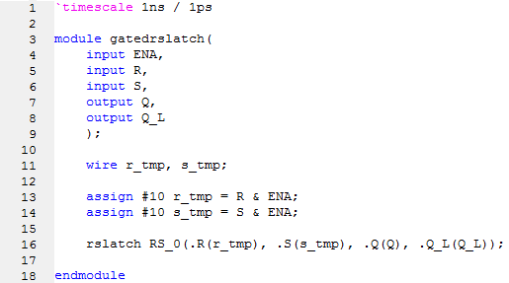
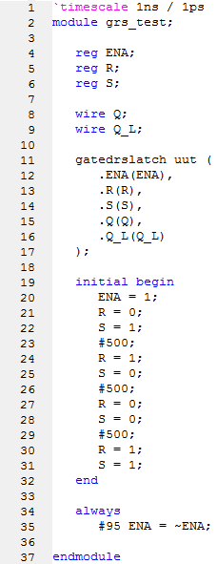
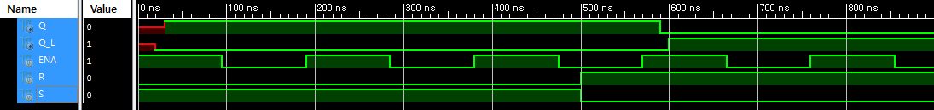
Verilog Implementation (Gated RS Latch)
<Module>
<Sample Testbench>
<Simulation>

Slide 18
Master-Slave Latches

Slide 19
Master-Slave structure & The 1s catching Problem
master stage
slave stage
R
R
Q’
P’
R
Q’
S
S
Q
P
S
Q
CLK
1s catch
Set
Reset
S
R
CLK
P
P’
Q
Q’
Master Outputs
Slave Outputs

Slide 20
Master-Slave structure & The 1s catching Problem
master stage
slave stage
R
R
Q’
P’
R
Q’
S
S
Q
P
S
Q
CLK
1s catch
Set
Reset
S
R
CLK
P
P’
Q
Q’
Master Outputs
Slave Outputs

Slide 21
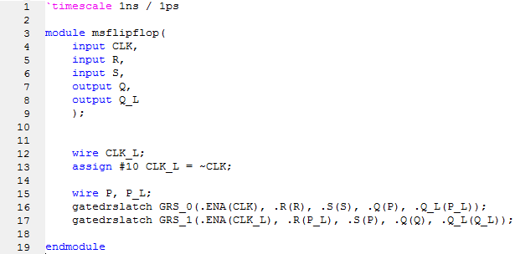
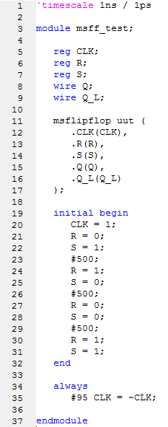
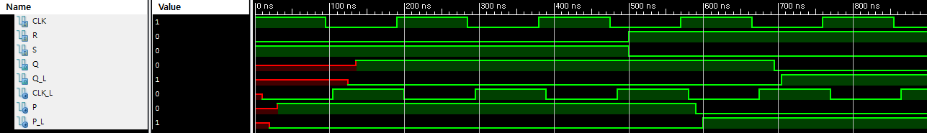
Verilog Implementation (Master-Slave Latches)
<Module>
<Sample Testbench>
<Simulation>

Slide 22
Lab

Slide 23
Lab & HW
Implement in Verilog, (1) an oscillator, (2) an RS latch, (3) a gated RS latch, and (4) master-slave latches. Simulate their behavior.
For master-slave latches, make a Verilog Testbench that clearly shows the 1s catching problem.
(HW0) Discuss what is the 1s catching problem and why it occurs.
Hint. Master-slave latches introduced on this lab operate as ?
In this point of view, discuss what is the 1s catching problem, why it occurs and why it is called as ‘problem’.

Slide 24
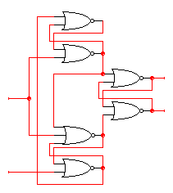
Homework
1.1. Implement the (negative) edge-triggered D flip-flop in Verilog
Gate level(diagram below) or RTL or Behavioral
1.2. Simulate its behavior
1.3. Discuss the similarities and differences between D F/F and Master-Slave latches
D’
D
holds D’ when
clock goes low
0
R
Q
Clk=1
Q’
S
0
holds D when clock goes low
D
D’

Slide 25
Homework
2.1. Implement the RS F/F in Verilog
Gate level or RTL or Behavioral
2.2. Simulate its behavior
2.3. Discuss the similarities and differences between SR F/F and D F/F

Slide 26
Homework
3.1. Implement the JK F/F in Verilog, using SR F/F from HW 2
3.2. Simulate its behavior
3.3. Discuss the similarities and differences between SR F/F and JK F/F
3.1. Might be tricky!
Hint. You can use external inputs to initialize the states
Do not forget HW 0 on slide 23 !

Slide 27
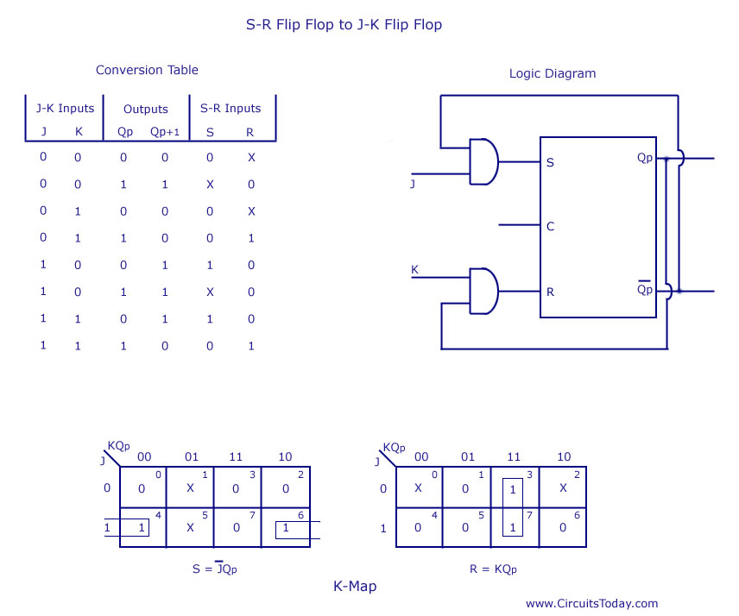
Homework
3.1. Implement the JK F/F in Verilog
3.2. Simulate its behavior
3.3. Discuss the similarities and differences between SR F/F and JK F/F
Hint. You can use external inputs to initialize the states

Slide 28
Homework
Ex.
3.1. Implement the JK F/F in Verilog
3.2. Simulate its behavior
3.3. Discuss the similarities and differences between SR F/F and JK F/F
Hint. You can use external inputs to initialize the states

Slide 29
Report
Write a report
# of pages doesn’t matter
All the files should be compressed to ZIP format
Your codes and simulations for every experiment should be included
The file size should be less than 15MB
Due : 28 Oct. (Before class begin at 7:00pm)

Slide 30
Appendix

Slide 31
wire & reg
Wire
Physical connections between modules
Propagate data at all time
Values are always updated as soon as the output of source component changes
Reg
Memory component
Propagate data at all time
Values are updated on specific condition
Values should be updated on specific condition
Module
A
1
Module
B
1

Slide 32
wire & reg
Wire
Physical connections between modules
Propagate data at all time
Values are always updated as soon as the output of source component changes
Reg
Memory component
Propagate data at all time
Values are updated on specific condition
Values should be updated on specific condition
Module
A
2
Module
B
2

Slide 33
wire & reg
Wire
Physical connections between modules
Propagate data at all time
Values are always updated as soon as the output of source component changes
Reg
Memory component
Propagate data at all time
Values are updated on specific condition
Values should be updated on specific condition
Module
A
Module
B
Module
A
1
Memory A
1
0
0

Slide 34
wire & reg
Wire
Physical connections between modules
Propagate data at all time
Values are always updated as soon as the output of source component changes
Reg
Memory component
Propagate data at all time
Values are updated on specific condition
Values should be updated on specific condition
Module
A
Module
B
Module
A
2
Memory A
2
2
2
Update
condition

Slide 35
wire & reg
Example: MAC (Multiplier-accumulator)
Operation: calculate “1x1 + 2x2 + 3x3 + …”
Use one memory component for partial sum (temporal output)
MAC
Psum

Slide 36
wire & reg
Example: MAC (Multiplier-accumulator)
Step 1
Input: 1
Output: 1x1
1
MAC
Psum
1x1
1
1

Slide 37
wire & reg
Example: MAC (Multiplier-accumulator)
Step 2
Input: 2
Output: 1x1 + 2x2
…And so on!
2
MAC
Psum
1x1 + 2x2
5
2

Slide 38
wire & reg
Example: MAC (Multiplier-accumulator)
We have to implement Psum as reg
Or, Psum value will be explode!
Because, wire updates its value as soon as the source changes
1
MAC
Psum
1x1 + 1x1 + 1x1 + …
5
1

Slide 39
wire & reg
Example: MAC (Multiplier-accumulator)
That’s why we use always block
always@(update_condition) begin
Psum <= Psum + A * B; //update Psum only update_condition met
…
end
2
MAC
Psum
1x1 + 2x2
5
2

